Slide 1

Properties
Dr. Nameeqa Firdous

Slide 2
Conservation of Charge
  Electrons are never created nor destroyed, but are simply transferred from one material to another

Slide 3
    Conservation of
    Charge
  No case of the creation or destruction of net electric charge has ever been found
  Electrons are always transferred in whole – they cannot be divided into fractions of electrons

Slide 4
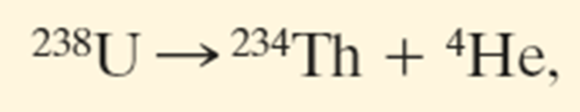
Conservation of Charge
Example 1:
Radioactive decay of nuclei, in which a nucleus transforms into (becomes) a different type of nucleus. A uranium-238 nucleus transforms into a thorium- 234 nucleus by emitting an alpha particle. An alpha particle has the same makeup as a helium-4 nucleus, it has the symbol ⁴He. Here the net charge is 92➔90+2.
Notes:
The hypothesis of conservation of charge has stood up under close examination, both for large-scale charged bodies and for atoms, nuclei, and elementary particles.

Slide 5
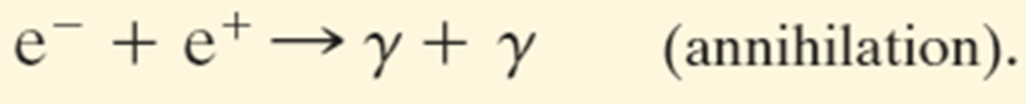
Conservation of Charge
Example 2:
An electron e⁻ (charge -e) and its antiparticle, the positron e⁺ (charge +e), undergo an annihilation process, transforming into two gamma rays (high-energy light):. Here the net charge is 0➔0.

Slide 6
Conservation of Charge
Example 3:
A gamma ray (in a certain environment) transforms into an electron and a positron. Here the net charge is again 0➔0.

Slide 7
Electrostatics
Electric charges at rest (static electricity)
Involves electric charges, forces between them, and their behavior in materials

Slide 8
Electric Forces
Arise from the particles in atoms
Alone: Billions and billions of times as strong as the force of gravity
In Pairs: Cancel each other out and have no noticeable effect

Slide 9
Coulomb’s Law
  The force between two charges depends on the magnitude of the charges and the distance between them
q₁q₂
F = k
d ²

Slide 10
Coulomb’s Law
q₁q₂
F = k
d ²
  Units of charge = Coulomb (C)
  k is a proportionality constant called the Coulomb constant
    k ≈ 9,000,000,000 ^{N·m2} or 9·10⁹ ^{N·m2}
_{C}2
_{C}2

Slide 11
Useful Numbers
Charge of an Electron | q_{e} = -1.6 · 10⁻¹⁹ C
Charge of a Proton | q_{p} = +1.6 · 10⁻¹⁹ C

Slide 12
Sample Problem
Two electrons are a meter apart.
What is the force between them?
What direction is it in?

Slide 13
Sample Problem
d = 1m
q_{p} = -1.6*10⁻¹⁹C q_{e} = -1.6*10⁻¹⁹C
q₁q₂
F = k
d ²
(-1.6*10⁻¹⁹C)* (-1.6*10⁻¹⁹C)
F = (9*10⁹N*m²/C²)
(1 m)²
F = 2.3*10⁻²⁸N

Slide 14
Sample Problem
Two electrons are two meters apart.
What is the force between them?
What direction is it in?

Slide 15
Coulomb’s Law
  The force between the two particles falls off as 1/d²
q₁q₂
F = k
d ²

Slide 16
Bell Ringer
Two electrons are two centrimeters apart.
What is the force between them?
What direction is it in?

Slide 17
Charging
Items may be charged by friction
  Electrons are moved from one object to another by being scraped away
Items may be charged by contact
  Electrons are moved without being scraped off

